Slide 1
Making this resource work for you
Prior to teaching this lesson, please refer to the ‘Unit Overview and Planning Document’.
Further guidance on planning Science Mastery lessons can be found in the detailed planning guidance document.
Refer to the ‘notes’ section on each slide for useful information, including suggested expositions, pedagogical content knowledge, suggested questions, answers and more. Consider using presenter mode so you can see this guidance throughout the lesson.
The introduction slides can be adapted to suit your teaching style and the needs of your class.
Before the lesson, adapt the fix-it slide to address any misconceptions identified in the previous lesson’s exit ticket.
Choose from the suggested activities to suit your class. The intention is not that you complete all of these, but that you select those which ones are most appropriate for your students. It may be appropriate to further adapt activities for your students.
These lessons are designed to occupy approximately 1 hour. To adapt for a shorter or longer lesson duration we advise you to adapt the activity section accordingly.
Please consider using the final slide to send feedback about this lesson or examples of PowerPoints that you have adapted to our design team. Your feedback is used to improve Science Mastery for all of our teachers and students. We appreciate all suggestions and comments.
Thank you for reading!
The Science Mastery Team

Slide 2

Taking it Further: Producing Ethanol from Fermentation
Answer the questions below.
Name the alcohol that contains two carbon atoms.
State the functional group of the alcohols.
Explain why alkenes are described as unsaturated.
Explain what is meant by the term anaerobic.
Name the process that takes place in cells to release energy.
Ethanol
Hydroxyl group (OH)
They contain a C=C double bond.
In the absence of oxygen
Respiration
Notes:
Big idea: Reactions rearrange matter
Foundation: Name the alkane with four carbons.
Stretch: Explain what is meant by a homologous series.
Answers:
Foundation: Butane
Stretch: A family of compounds with the same functional group.

Slide 3
Taking it Further: Producing Ethanol by Fermentation
Do Now:
Name the alcohol that contains two carbon atoms.
State the functional group of the alcohols.
Explain why alkenes are described as unsaturated.
Explain what is meant by the term anaerobic.
Name the process that takes place in cells to release energy.
Drill:
State the chemical formula of ethanol.
Compare the structures of ethene and ethanol.
Give a use of ethanol.
Notes:
Drill answers:
C₂H₅OH
Both contain two carbon atoms. Ethene contains four hydrogen atoms, whereas ethanol contains 5 hydrogens atoms on the main chain, then a hydroxyl group, which ethene does not have. Ethene contains a C=C double bond, which ethanol does not have.
As a fuel, a solvent or in alcoholic drinks.

Slide 4
Taking it Further: Producing Ethanol by Fermentation
Read Now:
Fermentation is an anaerobic chemical process because takes place in the absence of oxygen. It is used to make many products for humans, including bread and alcoholic drinks. It has also now been suggested that eating fermented foods, such as kimchi or kombucha, can have a beneficial effect on gut health. Foods that have been fermented have started to undergo breakdown by microorganisms such as yeast or bacteria, which produces products that give the food a different flavour. Gut microbiologists suggest that eating fermented food, which contain cultures of different microorganisms, can increase the gut biodiversity and provide health benefits.
Explain why fermentation is an anaerobic process.
Give an example of a product that humans make from fermentation.
Give an example of a fermented food.
Describe the advantages of eating fermented food that microbiologists suggest.

Slide 5

C5.1.8
16/10/2024
Taking it Further: Producing Ethanol by Fermentation
C5.1.1 Prior Knowledge Review
C5.1.2 Crude Oil and Hydrocarbons
C5.1.3 Fractional Distillation
C5.1.4 Combustion of Hydrocarbons
C5.1.5 Cracking
C5.1.6 Taking it Further: Alkenes
C5.1.7 Taking it Further: Alcohols
C5.1.8 Taking it Further: Producing Ethanol by Fermentation
C5.1.9 Taking it Further: Producing Ethanol from Ethene
C5.1.10 Taking it Further: Carboxylic Acids
C5.1.11 Taking it Further: Esters
C5.1.12 Polymers
C5.1.13 Taking it Further: Addition Polymerisation
C5.1.14 Taking it Further: Condensation Polymerisation
C5.1.15 Taking it Further: Naturally Occurring Polymers
Notes:
Big Idea: Structure Determines Properties
In this lesson, students will look at the first of two different methods of producing ethanol, which builds to students being able to evaluate the advantages and disadvantages of each.
Suggested Hook:
How is alcohol made?

Slide 6

Following this lesson, students will be able to:
State the equation for the production of ethanol through fermentation
Describe the conditions required for fermentation
Describe the advantages and disadvantages of producing ethanol by fermentation
Key Words:
alcohol
ethanol
fermentation
anaerobic
yeast
Notes:
Guidance:
See unit overview document and planning guidance to see how these objectives are typically assessed at GCSE, including examples of what students should be able to do following this lesson.
Planning for different needs:
The learning objectives given on this slide are suggested based on the most common requirements for exams, however they can be adapted based on the needs of different classes.
For best practice, the unit preparation booklet should be used to determine the appropriate focus of lessons within the unit.
While it is not possible to explicitly split content into levelled grades, we recommend that lesson objectives can be classified as critical, core or stretch.
Critical: the content or skill is essential for all students to be able to progress.
Core: the content or skill is important for students to progress, but other opportunities may be available to revisit it.
Stretch: the content or skill may not be essential for all students but is important for students aiming for the highest grades.
Key skill: this is a crucial skill being developed in this unit as part of the skill mapping
C5.1.8 Lesson Objectives:
Critical: State the equation for the production of ethanol through fermentation
Critical: Describe the conditions required for fermentation
Core: Describe the advantages and disadvantages of producing ethanol by fermentation

Slide 7
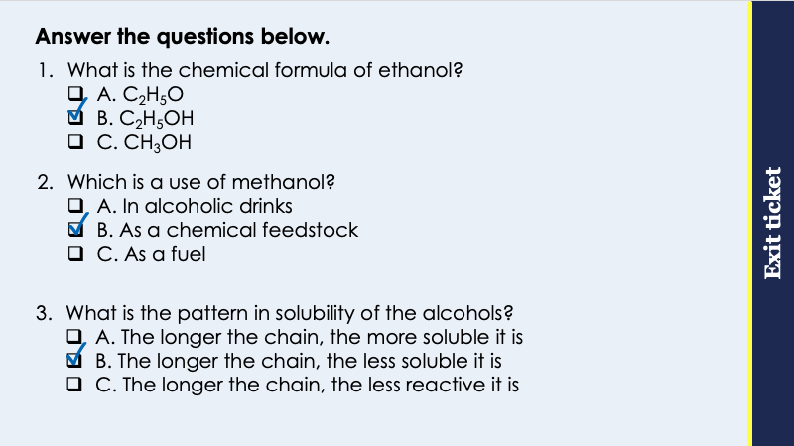
This is the fix-it portion of the lesson
The fix-it is an opportunity to respond to gaps in knowledge, especially those identified by the pre-unit quiz.
The teacher should customise this slide as needed, to facilitate
reteach, explanation, demonstration or modelling of ideas and concepts that students have not yet grasped or have misunderstood.
practise answering specific questions or of key skills.
redrafting or improving previous work.
Notes:
Purpose: to spend time on any gaps identified in previous learning from previous exit ticket.
Guidance from previous exit ticket:
Q1. Answer: B
If students answer A, they have not identified the importance of the hydroxyl group. If students answer C, they have confused the formulae of methanol and ethanol. To fix it, review the general formula for the alcohols and the naming conventions.
Q2. Answer: B
If students answer A, they have confused the use of methanol and ethanol. If students answer C, they have confused the use of methanol with propanol and butanol. To fix it, review what each of the alcohols is useful for.
Q3. Answer: B
If students answer A, they have not identified the correct pattern. If students answer C, they have not understood the difference between reactivity and solubility. To fix it, review what is meant by solubility and the pattern of solubility in the alcohols.

Slide 8
Ethanol
Ethanol is an alcohol.
Ethanol
C₂H₅OH
It is useful as a solvent, a fuel or in alcoholic drinks.
H
H
H
C
C
O
H
It can be made in different ways:
Fermentation
Hydration of ethene
H
H
Notes:
Suggested exposition:
In the last lesson, we looked at the homologous series called the alcohols.
What functional group do the alcohols have?
Hydroxyl (OH group).
What is the name of the alcohol with two carbon atoms?
Ethanol.
In this lesson, we’re going to look more at ethanol and how it can be made.
So we know ethanol is an alcohol. We also know from the last lesson that it can be used as a fuel, a solvent, or in alcoholic drinks.
It can be made in a couple of different ways: fermentation, and hydration of ethene. In this lesson, we will look at producing ethanol by fermentation then in the next lesson we will look at producing ethanol by hydration of ethene.

Slide 9
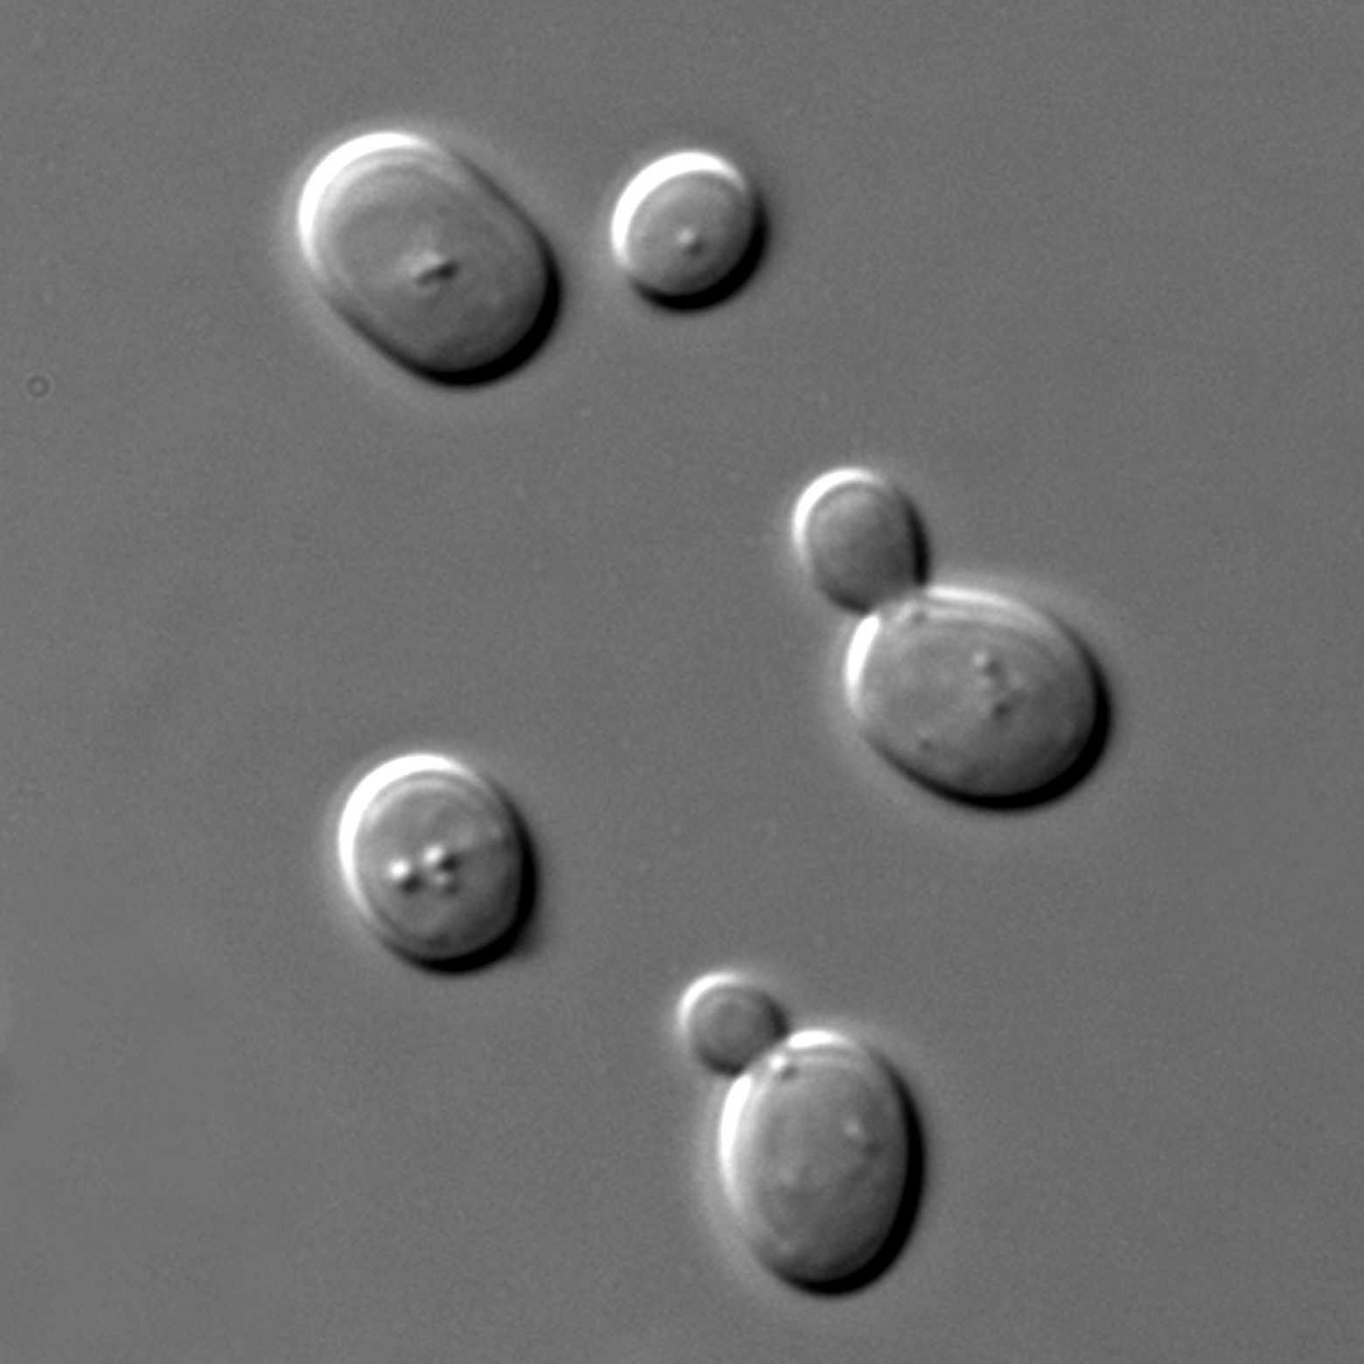
Fermentation
Did you know?
One yeast cell is tiny - just one teaspoon holds about 75 billion cells
Fermentation is when microorganisms start to break down glucose in the absence of oxygen.
Glucose → ethanol + carbon dioxide
Ethanol can be used to make alcoholic drinks, as a solvent or as a fuel, either by itself or mixed with petrol.
Ethanol produced through fermentation can be distilled to increase the purity.
Carbon dioxide produced is also useful in baking.
Notes:
Suggested exposition:
As we know, all living things need to carry out respiration in their cells to survive. Unicellular organisms such as bacteria and yeast use anaerobic respiration to release energy from glucose.
What is anaerobic respiration?
Respiration in the absence of oxygen.
Fermentation is an anaerobic process, which means that it also takes place in the absence of oxygen. Fermentation is only a part of the anaerobic respiration process, it is not the same as anaerobic respiration. Fermentation is when microorganisms (such as bacteria or yeast) start to break down glucose in the absence of oxygen.
Fermentation to produce ethanol uses yeast as the microorganism. Did you know that yeast cells are so small that 1 teaspoon holds about 75 billion cells! Yeast are a type of unicellular fungus. Both the products of fermentation have uses for us in making food and drinks. Ethanol is the alcohol found in alcoholic drinks. When beer and wine are made, yeast is added to various ingredients and allowed to ferment. Over time this produces the alcoholic drink. For example, wine is made from grapes and the yeast cells use the glucose sugar found in the grapes to carry out fermentation. The resulting mixture makes the alcoholic drink wine.
The other product of fermentation is also useful, in this case it is to bake bread. The carbon dioxide produced is useful to make bread rise so that it contains many small air holes and results in a spongy or fluffy texture. After dough is made from flour, water, yeast and sugar, it is left to ‘prove’ or ‘rise’ so that the yeast cells have a chance to ferment and produce carbon dioxide gas bubbles. This is what is happens when dough rises before it is baked.
There is no alcohol in bread but as you can see in the chemical reaction, ethanol is produced during fermentation.
Where do you think the alcohol from the fermentation goes during bread making?
Ethanol evaporates leaving the bread during the baking process.
Ethanol produced through fermentation can also be used as a fuel, either by itself or mixed with petrol.
Once ethanol has been produced through fermentation, it is usually fairly low purity, so it can be distilled to separate the pure ethanol from other substances in the mixture.
Note: fermentation only involves glycolysis, so glucose is not broken down fully. Students do not need to know this level of detail until A-Level.
Image: https://commons.wikimedia.org/wiki/File:Figure_09_04_01.jpg – this shows yeast under a light microscope. We are looking at the outside surface of these cells. There are two budding cells and three not budding. This type of yeast used for fermentation is called Saccharomyces cerevisiae.

Slide 10
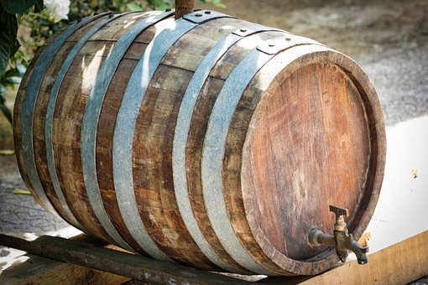
Conditions for Fermentation
For fermentation to take place, there must be:
A sugar solution, mixed with yeast
No air or oxygen getting in (anaerobic)
A warm temperature (25 - 35 ºC)
The enzymes in yeast can be denatured if they are over heated, meaning they can no longer function.
Fermentation is a slow process and can take days or even weeks.
Notes:
Suggested exposition:
Yeast is the microorganism often used for fermentation. It is a unicellular fungus.
What does unicellular mean?
Made up of one cell only.
The conditions generally required for fermentation are
A sugar solution, mixed with yeast
Aerobic conditions (no oxygen), but it can be useful to allow carbon dioxide to escape.
a warm temperature of 25-35°C
Yeast provides the enzymes needed for fermentation. As there are enzymes involved in the process, their activity is affected by temperature.
What happens when enzymes are heated too much?
They become denatured and can no longer function.
As with the human body, enzymes in yeast have an optimum temperature range that they work best at. In yeast, this is 25-35 ºC, so a warm temperature but not too hot.
When the ethanol concentration gets too high (above 15% of the mixture), the yeast starts to die.
Fermentation is a slow reaction and can take several days or weeks.
If the reaction is not anaerobic (so air is present), the ethanol is oxidised to form ethanoic acid, which is vinegar. This can be what is tasted/smelled when a bottle of wine is left open for too long.
Image from pixabay

Slide 11




Which statements do you agree with?
Fermentation is an anaerobic process
Fermentation is an aerobic process
Ethanol can be used as a fuel
Ethanol can be used in baking
Notes:
Suggested points:
Blue: incorrect
Yellow: correct
Green: correct
Pink: incorrect - the other product of fermentation (carbon dioxide) is used in baking.
Suggested guidance:
Talk tasks can be used in a variety of ways to suit the particular needs of the students you are teaching. Through exchanging views with others, students develop their understanding of the science beyond what could be achieved individually.
Science classrooms that successfully integrate talk have the following features:
Science talk is a regular feature of lessons and is woven into classroom activities.
Students are paired or grouped strategically by the teacher to ensure productive interaction. This might take into consideration the students’ proficiency of the English language, how encouraging they might be to peers and their attainment in the topic. It’s a good idea to consider these pairings in the class seating plan.
Students are encouraged and supported to talk, but are not forced to talk.
The teacher should take on the role of a facilitator, engaging with conversations where necessary and encouraging or steering the conversation where needed.
Students are encouraged to use the language they have to express their ideas (e.g., everyday language, imperfect English, native language), but also to incorporate science specific terminology where this is more accurate or has been taught.
6. Scientifically inaccurate ideas are not dismissed by the partner or teacher; open discussion and further investigation are relied on to help students construct ideas that support them to progress in their scientific understanding.
7. Guidelines for behaviour during talk tasks are explicit and frequently reviewed. Rules for students might be:
Listen carefully to your partner
Take turns talking.
Speak one at a time, without interrupting.
Politely agree or disagree and explain why.
Politely point out if your partner has used a scientific word incorrectly, if they have explained the science incorrectly, or if there is a more accurate way to describe something.
If confused, ask questions.
Stay focused on the discussion topic.
Respond to one another.

Slide 12
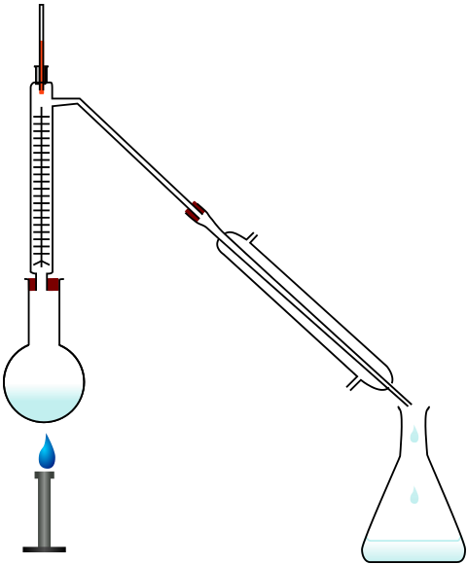
How could the purity of ethanol be increased by distillation?
Boiling point of water: 100 ºC
Boiling point of ethanol: 78 ºC
A solution of ethanol can be purified using distillation.
What changes of state would be involved in distillation?
What would be found at point X?
What would be found at point Y?
X
Y
Notes:
Suggested points:
Evaporation and condensation are involved.
Ethanol has the lower boiling point so would evaporate first, forming vapour at point X.
Point Y would be liquid ethanol after it has condensed.
Suggested guidance:
Talk tasks can be used in a variety of ways to suit the particular needs of the students you are teaching. Through exchanging views with others, students develop their understanding of the science beyond what could be achieved individually.
Science classrooms that successfully integrate talk have the following features:
Science talk is a regular feature of lessons and is woven into classroom activities.
Students are paired or grouped strategically by the teacher to ensure productive interaction. This might take into consideration the students’ proficiency of the English language, how encouraging they might be to peers and their attainment in the topic. It’s a good idea to consider these pairings in the class seating plan.
Students are encouraged and supported to talk, but are not forced to talk.
The teacher should take on the role of a facilitator, engaging with conversations where necessary and encouraging or steering the conversation where needed.
Students are encouraged to use the language they have to express their ideas (e.g., everyday language, imperfect English, native language), but also to incorporate science specific terminology where this is more accurate or has been taught.
6. Scientifically inaccurate ideas are not dismissed by the partner or teacher; open discussion and further investigation are relied on to help students construct ideas that support them to progress in their scientific understanding.
7. Guidelines for behaviour during talk tasks are explicit and frequently reviewed. Rules for students might be:
Listen carefully to your partner
Take turns talking.
Speak one at a time, without interrupting.
Politely agree or disagree and explain why.
Politely point out if your partner has used a scientific word incorrectly, if they have explained the science incorrectly, or if there is a more accurate way to describe something.
If confused, ask questions.
Stay focused on the discussion topic.
Respond to one another.
Image source:
CC@https://commons.wikimedia.org/wiki/File:Fractional_distillation_lab_apparatus_blank_version.svg

Slide 13
Determine whether each of these statements is true or false
False
Ethane is made using fermentation
Fermentation is an aerobic process
Fermentation produces lactic acid
Fermentation produces ethanol and carbon dioxide
Ethanol is found in alcoholic drinks
Ethanol can be mixed with petrol and used as a fuel
False
False
True
True
True

Slide 14
Drill
Explain why fermentation is an anaerobic process.
State the reactant for fermentation.
State the products of fermentation.
Describe the conditions required for fermentation.
Give a use of ethanol produced through fermentation.
Give a use of carbon dioxide produced through fermentation.
Describe how ethanol produced through fermentation can be purified.
Notes:
Purpose: This is a knowledge drill. The purpose of this is to check that the critical knowledge is secure before pupils move onto independent practice.
Suggested guidance: There are a range of ways this could be done depending on time and ability range of the class:
Mini whiteboards
As full sentences in exercise books
As short answers in exercise books
In the pupil workbook
As pair talk
As cold call

Slide 15
Drill answers
It takes place in the absence of oxygen.
Glucose
Ethanol and carbon dioxide
A temperature of 25-35 ºC, no oxygen and a sugar solution mixed with yeast.
As a solvent, a fuel or in alcoholic drinks
In baking (to make dough rise)
Using distillation, as ethanol has a lower boiling point than water so can be separated using evaporation and condensation.
Notes:
Purpose: This is a knowledge drill. The purpose of this is to check that the critical knowledge is secure before pupils move onto independent practice.
Suggested guidance: There are a range of ways this could be done depending on time and ability range of the class:
Mini whiteboards
As full sentences in exercise books
As short answers in exercise books
In the pupil workbook
As pair talk
As cold call

Slide 16

I: Describe: to recall facts, events or processes in an accurate way
Example question:
To ‘describe’, your answer should:
Use bullet points to keep your answer clear
Cover enough points to fully answer the question
Use scientific keywords in your answer
‘Say what you see’ if there is a diagram, graph or table.
Describe the advantages of producing ethanol by fermentation.
Rate of reaction | Low
Purity of ethanol produced | 10-15%
Energy usage | Low
Raw material used | Sugar
Model answer:
Fermentation does not use much energy
Fermentation uses sugar as the raw material, which is a renewable resource
Notes:
Purpose: The I-We-You section aims to support pupils to build skills that they most commonly need when answering questions associated with this knowledge in the assessment. This section is also used to interleave other content we expect pupils to know at this stage of their education in order that they build a big picture of the science they are learning.
For the ‘I’ activity, the teacher should model how to answer the question. They can do this by narrating their thinking process aloud, and making links to learning earlier in the lesson explicit.
For the ‘we’ activity, the teacher and students work though a similar example together, in order to prepare students to be able to answer a similar question independently.
Opportunities for the ‘you’ activity – independent practise – occur in the activity portion of the lesson once the student is secure enough to process independently.
This slide models the process of answering a describe question.
Firstly, students are presented with a generic describe question, along with a model answer. Students are also given some simple guidance to follow for producing their own describe answer.
The generic question and answer should be used by the teacher to remind students of
the key features of a great answer
how to structure their answer
why the model answer is a good example
Following this, students will be required to apply this process to answer their own describe question, which will appear in place of the generic questions. This describe question will be specific to the topic students are learning about in the lesson. Give students time to write their own answer to this, ensuring that they use the guidance provided. To further scaffold this task for students, it may be appropriate to:
pair students up to write an answer together
list for students the key words you would like them to include in the answer
provide a writing frame or ‘points to include’ for students
A model answer for this question will appear. Teachers should review the model answer with students by referencing the guidance in the green box. For example ‘we can see item 1 in the guidance is to use bullet points to keep your answer clear. Notice in the model answer here we have done just that’. Or ‘item 2 in the guidance here says that we should use scientific keywords in the answer. Has this been achieved in the model answer? Where can we see this?’.

Slide 17
We: Describe: to recall facts, events or processes in an accurate way
Example question:
To ‘describe’, your answer should:
Use bullet points to keep your answer clear
Cover enough points to fully answer the question
Use scientific keywords in your answer
‘Say what you see’ if there is a diagram, graph or table.
Describe the disadvantages of producing ethanol by fermentation.
Rate of reaction | Low
Purity of ethanol produced | 10-15%
Energy usage | Low
Raw material used | Sugar
Model answer:
Fermentation takes a long time as there is a low rate of reaction
Fermentation produces ethanol with relatively low purity, so may need to be distilled
Notes:
Purpose: The I-We-You section aims to support pupils to build skills that they most commonly need when answering questions associated with this knowledge in the assessment. This section is also used to interleave other content we expect pupils to know at this stage of their education in order that they build a big picture of the science they are learning.
For the ‘I’ activity, the teacher should model how to answer the question. They can do this by narrating their thinking process aloud, and making links to learning earlier in the lesson explicit.
For the ‘we’ activity, the teacher and students work though a similar example together, in order to prepare students to be able to answer a similar question independently.
Opportunities for the ‘you’ activity – independent practise – occur in the activity portion of the lesson once the student is secure enough to process independently.
This slide models the process of answering a describe question.
Firstly, students are presented with a generic describe question, along with a model answer. Students are also given some simple guidance to follow for producing their own describe answer.
The generic question and answer should be used by the teacher to remind students of
the key features of a great answer
how to structure their answer
why the model answer is a good example
Following this, students will be required to apply this process to answer their own describe question, which will appear in place of the generic questions. This describe question will be specific to the topic students are learning about in the lesson. Give students time to write their own answer to this, ensuring that they use the guidance provided. To further scaffold this task for students, it may be appropriate to:
pair students up to write an answer together
list for students the key words you would like them to include in the answer
provide a writing frame or ‘points to include’ for students
A model answer for this question will appear. Teachers should review the model answer with students by referencing the guidance in the green box. For example ‘we can see item 1 in the guidance is to use bullet points to keep your answer clear. Notice in the model answer here we have done just that’. Or ‘item 2 in the guidance here says that we should use scientific keywords in the answer. Has this been achieved in the model answer? Where can we see this?’.

Slide 18
You: Describe: to recall facts, events or processes in an accurate way
Example question:
To ‘describe’, your answer should:
Use bullet points to keep your answer clear
Cover enough points to fully answer the question
Use scientific keywords in your answer
‘Say what you see’ if there is a diagram, graph or table.
Describe the advantages and disadvantages of producing ethanol by fermentation.
Rate of reaction | Low
Purity of ethanol produced | 10-15%
Energy usage | Low
Raw material used | Sugar
Model answer:
Fermentation takes a long time as there is a low rate of reaction
Fermentation produces ethanol with relatively low purity, so may need to be distilled
Fermentation takes a long time as there is a low rate of reaction
Fermentation produces ethanol with relatively low purity, so may need to be distilled
Notes:
Purpose: The I-We-You section aims to support pupils to build skills that they most commonly need when answering questions associated with this knowledge in the assessment. This section is also used to interleave other content we expect pupils to know at this stage of their education in order that they build a big picture of the science they are learning.
For the ‘I’ activity, the teacher should model how to answer the question. They can do this by narrating their thinking process aloud, and making links to learning earlier in the lesson explicit.
For the ‘we’ activity, the teacher and students work though a similar example together, in order to prepare students to be able to answer a similar question independently.
Opportunities for the ‘you’ activity – independent practise – occur in the activity portion of the lesson once the student is secure enough to process independently.
This slide models the process of answering a describe question.
Firstly, students are presented with a generic describe question, along with a model answer. Students are also given some simple guidance to follow for producing their own describe answer.
The generic question and answer should be used by the teacher to remind students of
the key features of a great answer
how to structure their answer
why the model answer is a good example
Following this, students will be required to apply this process to answer their own describe question, which will appear in place of the generic questions. This describe question will be specific to the topic students are learning about in the lesson. Give students time to write their own answer to this, ensuring that they use the guidance provided. To further scaffold this task for students, it may be appropriate to:
pair students up to write an answer together
list for students the key words you would like them to include in the answer
provide a writing frame or ‘points to include’ for students
A model answer for this question will appear. Teachers should review the model answer with students by referencing the guidance in the green box. For example ‘we can see item 1 in the guidance is to use bullet points to keep your answer clear. Notice in the model answer here we have done just that’. Or ‘item 2 in the guidance here says that we should use scientific keywords in the answer. Has this been achieved in the model answer? Where can we see this?’.

Slide 19
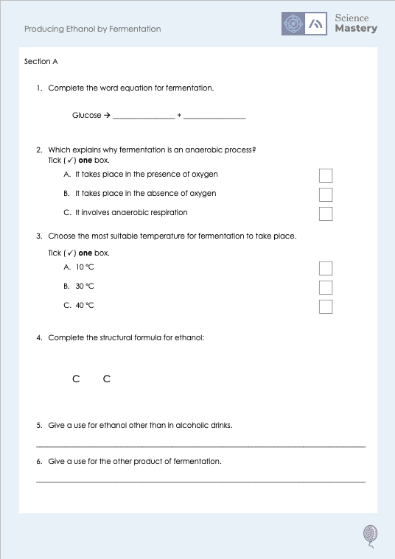
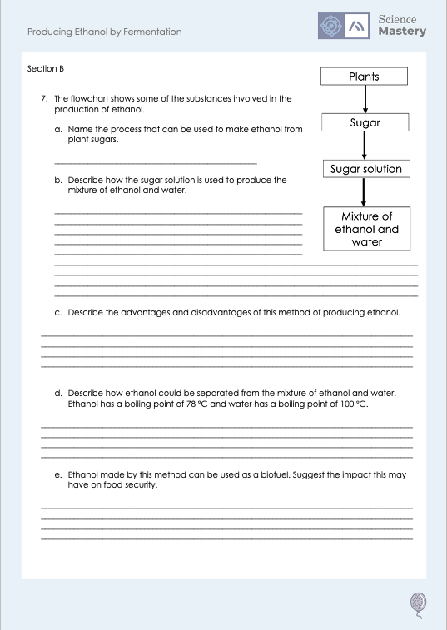
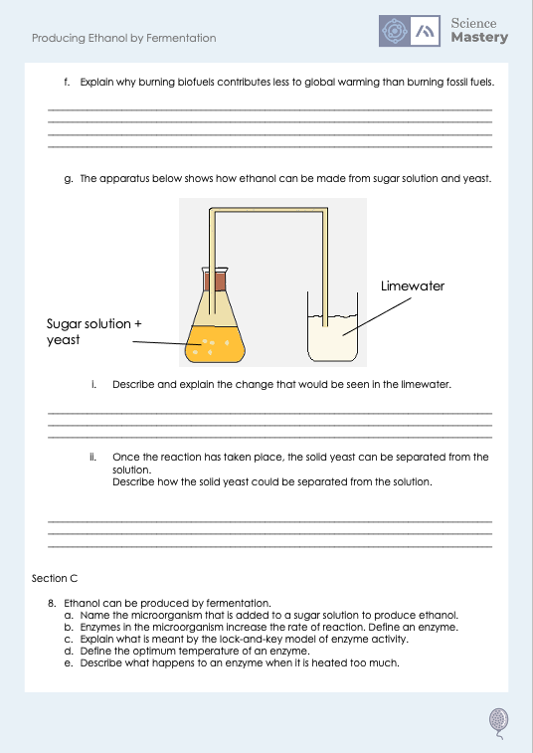
Worksheet

Slide 20
Answers
1. Ethanol + carbon dioxide
2. B - It takes place in the absence of oxygen
3. B - 30 ºC
4.
H
H
H
H
C C O
H
H
5. As a fuel or a solvent
6. In baking, making dough rise

Slide 21
Answers
7a. Fermentation
7b.
Add yeast
Allow to ferment (leave at 25-35 ºC with no oxygen)
7c.
Advantages
Low energy cost
Raw material (sugar) is renewable
Disadvantages
Low rate of reaction Ethanol produced is low purity
7d.
Heat the mixture
Ethanol will vaporise first (as it has the lower boiling point)
Then condense/cool

Slide 22
Answers
7e.
Land may be used to grow crops for biofuel production rather than food crops
This could decrease food security
7f.
Burning ethanol still produces carbon dioxide (like burning fossil fuels)
but carbon dioxide is taken in while the crops for biofuels are growing
So net carbon dioxide emissions are lower
7gi.
Limewater would turn cloudy
because the other product of fermentation is carbon dioxide
7gii.
Using filtration
The solid yeast would not pass through filter paper, but the solution/liquid would

Slide 23
Answers
8a. Yeast
8b. A biological catalyst (which speeds up a chemical reaction without being used up).
8c. Enzymes are specific to substrates as their active sites are complementary like a lock and a key.
8d. The temperature at which the enzyme works best.
8e. Enzymes can become denatured, and their active site can no longer fit with the substrate.

Slide 24
Answer the questions below.
Choose the word equation for fermentation.
A. Glucose → lactic acid
B. Glucose → ethanol + carbon dioxide
C. Glucose + ethanol → carbon dioxide
✓
Why should fermentation take place at a warm temperature?
A. So the reaction does not happen too quickly
B. So the enzymes in yeast are not denatured
C. So the ethanol can be evaporated
✓
What is a disadvantage of producing ethanol by fermentation?
A. It is a very quick process
B. It can take days or weeks
C. It does not require much energy
✓
Notes:
Q1. Answer: B
If students answer A, it suggests they have confused the equations for fermentation and anaerobic respiration. If students answer C, it suggests they have forgotten that ethanol is a product of fermentation and not a reactant. To fix-it, recap how fermentation is an important process in making alcoholic drinks then ask students to write out the fermentation word equation and annotate what the products are useful for in food and drink production.
Q2. Answer: B
If students answer A, they have confused the play off between rate of reaction and enzyme activity. If students answer C, they are confusing fermentation to produce ethanol with distillation to separate it. To fix it, review the conditions needed for fermentation.
Q3. Answer: B
If students answer A, they have not identified that fermentation is a slow process. If students answer C, they have chosen an advantage rather than a disadvantage. To fix it, review the advantages and disadvantages of fermentation.

Slide 25
Lesson C5.1.8
What was good about this lesson? | What can we do to improve this lesson?
Send us your feedback by clicking this link
or by emailing sciencemastery@arkonline.org
Thank you!

